Slide 1
Operation Analytics and Investigating Metric Spike

Slide 2
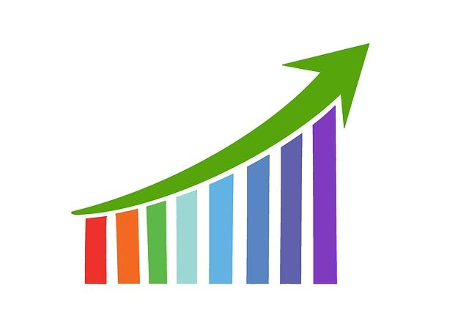
AGENDA
.Project Description
.Approach
.Tech-stack Used
. Insights
. Results
. Conclusion

Slide 3
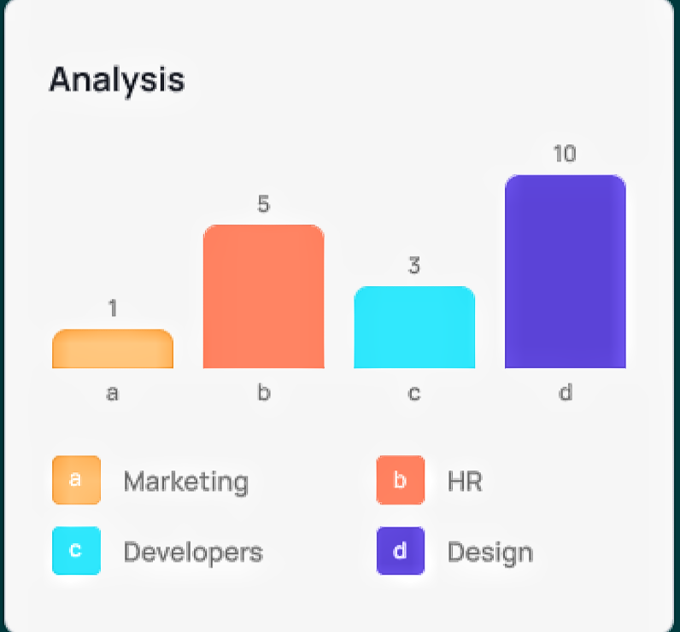
Project Description
Operation Analytics is the analysis done for the complete end to end operations of a company. With the help of this, the company then finds the areas on which it must improve upon. I’ve worked with the ops team, support team, marketing team and help them derive insights out of the data they collect.
Being one of the most important parts of a company, this kind of analysis is further used to predict the overall growth or decline of a company’s fortune.

Slide 4

Approach
1. Created the Database and Tables: Created a database and then the tables using the structure and links provided. 2. Perform Analysis: Used SQL to perform entire analysis answering the questions asked. I went through the given dataset and then created the tables for calculating various queries. 3. Additionally, I joined the data bits and structured the tables to derive business insights, fetched the required results and hence, created useful insights for the company to take calculated and planned decisions.

Slide 5
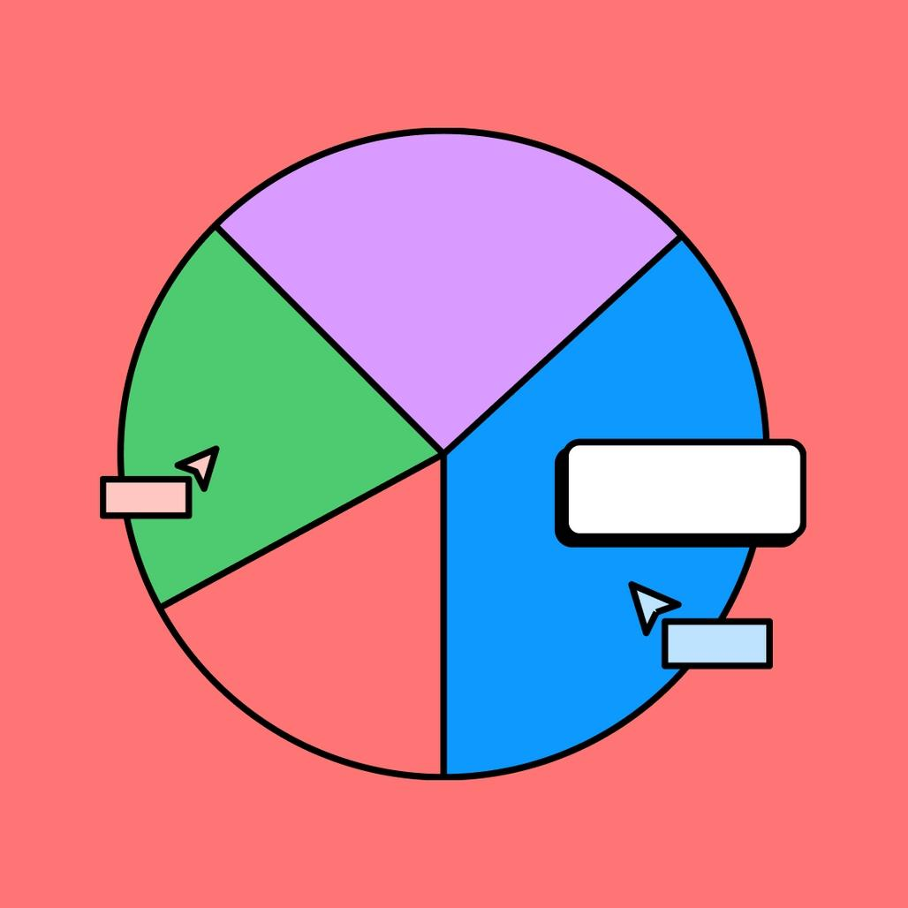
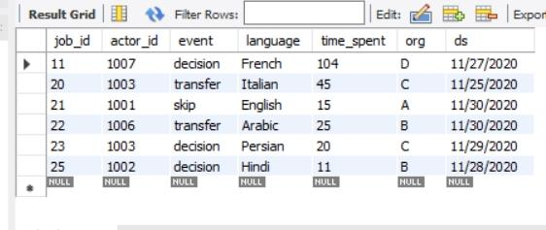
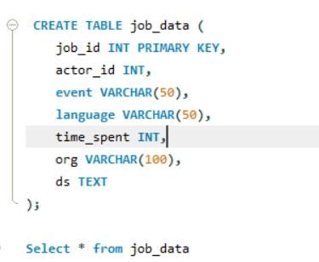
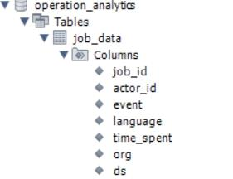
Case study 1
Table data
➡️
➡️

Slide 6
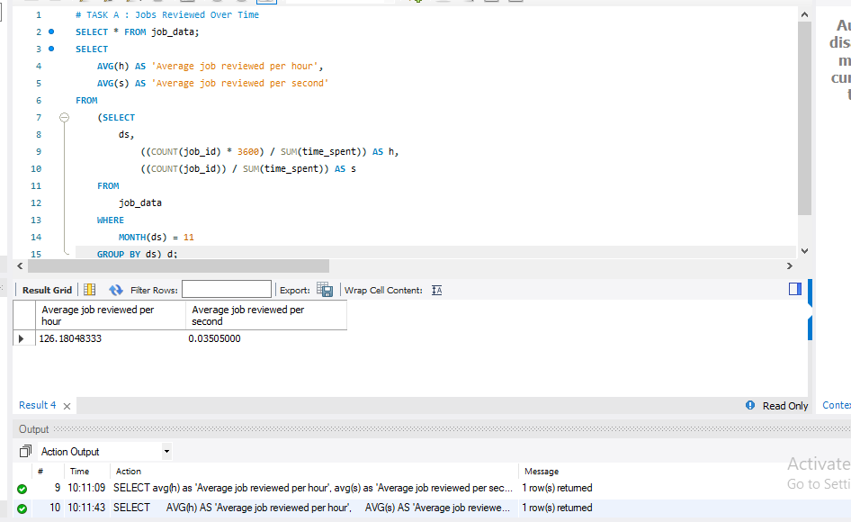
Jobs Reviewed Over Time
Calculate the number of jobs reviewed per hour for each day in November 2020.

Slide 7
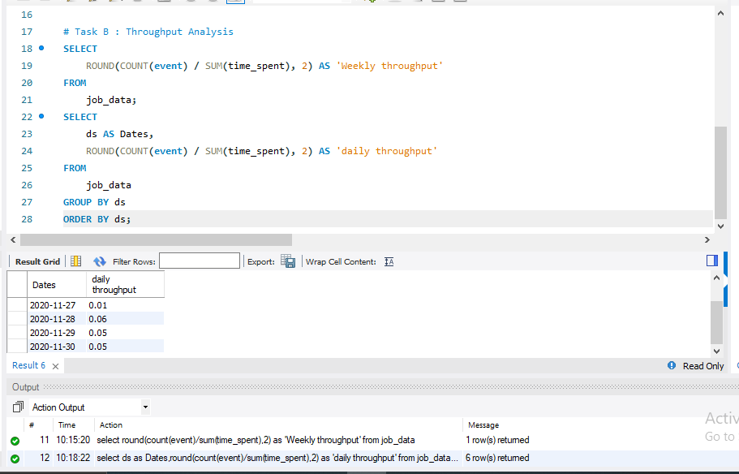
Throughput Analysis
Calculate the 7-day rolling average of throughput

Slide 8
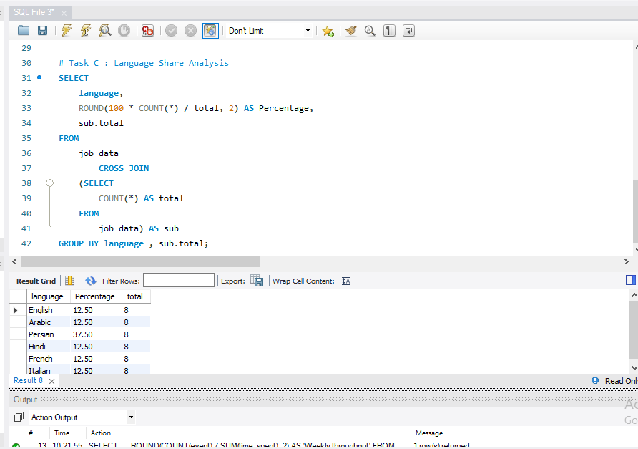
Language Share Analysis
Calculate the percentage share of each language in the last 30 days.
↘️

Slide 9
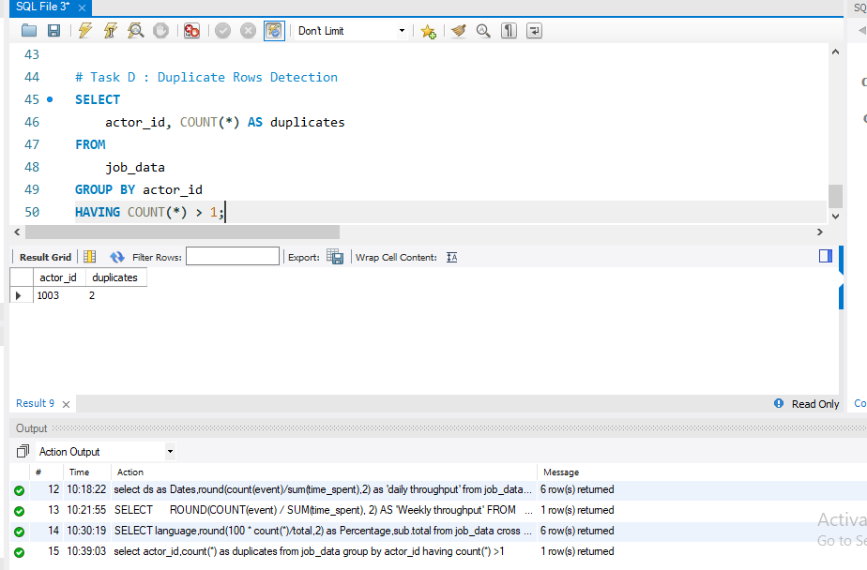
Duplicate Rows Detection
Identify duplicate rows in the data

Slide 10




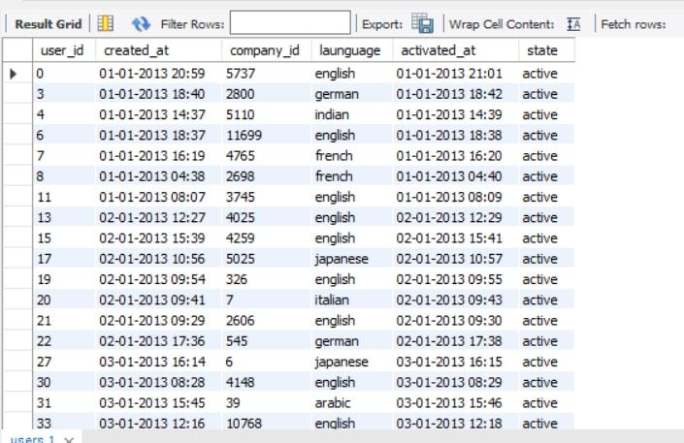
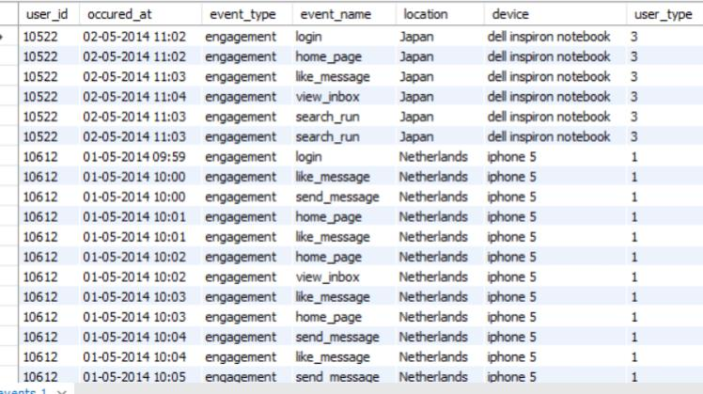
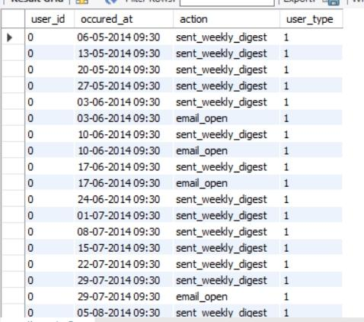
Case Study 2
Table Data
Users
Events
Email -Events

Slide 11
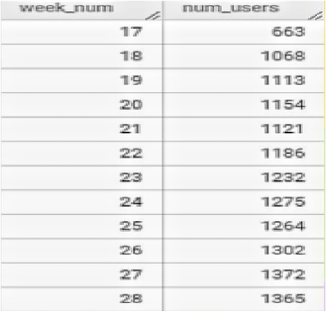
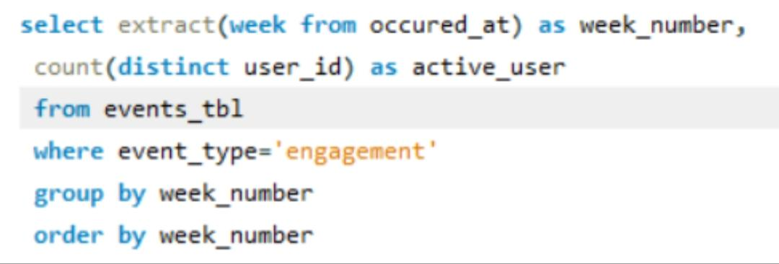
Weekly User Engagement
Measure the activeness of users on a weekly basis.
➡️
.Highest user week: 28
. Minimum user week : 17

Slide 12
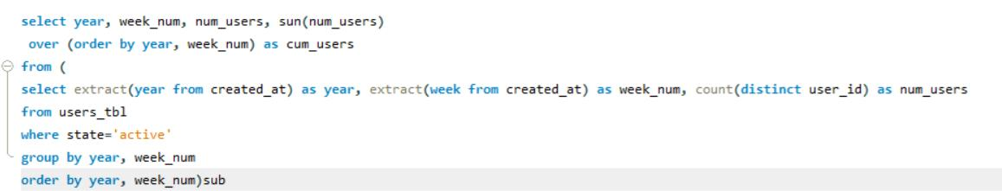
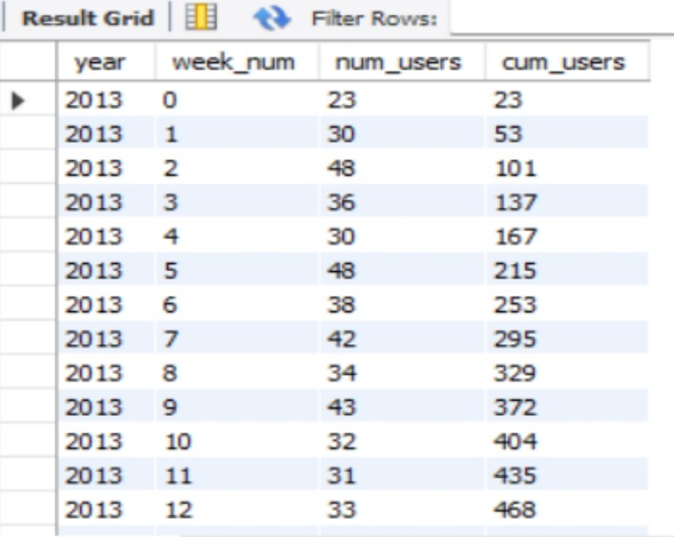
User Growth Analysis
Analyze the growth of users over time for a product
⬇️
The 12th 33 week of 2014 saw the greatest number of users
The lowest was on 35th week 2014

Slide 13
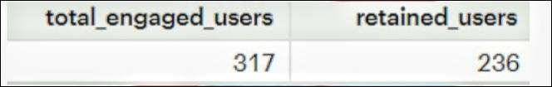
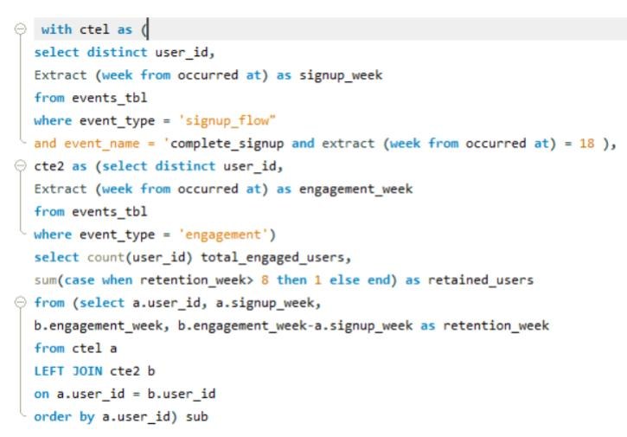
Weekly Retention Analysis
Analyze the retention of users on a weekly basis after signing up for a product
➡️
30% of the users retained in week 18 were retained only for the next 7 days.
User 11816 was retained for the longest duration i.e. 17weeks

Slide 14
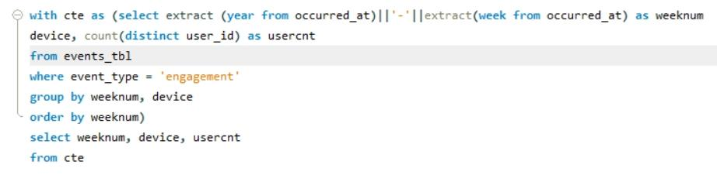
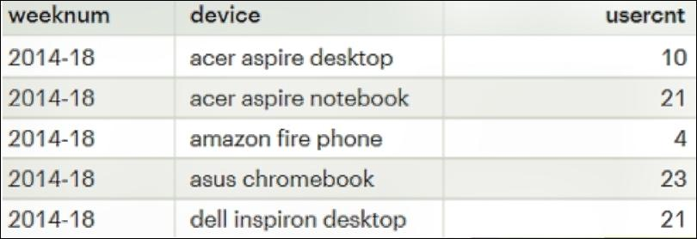
Weekly Engagement Per Device
Measure the activeness of users on a weekly basis per device.
Weeks 31 & 32 of the year 2014 had the highest user engagement of 317 users each week for the product and the device being used was “MacBook Pro” for both the weeks
⬇️

Slide 15
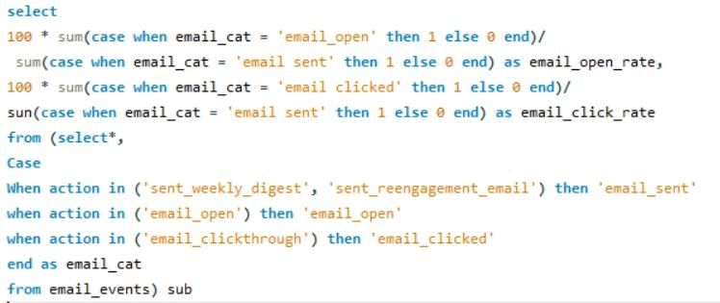
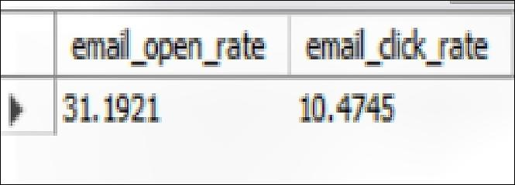
Email Engagement Analysis
Analyze how users are engaging with the email service.
➡️
Out of the total emails sent, around 35.73% of them were opened and only 15.74% of those emails were clicked

Slide 16
Results
>Less than 0.01 jobs were reviewed each hour of the day throughout the month of November.
> 7 day rolling average is best for throughput.
> The Persian Language had the highest share among other languages.
> Out of the total emails sent, around 35.73% of them were opened and only 15.74% of those emails were clicked.
>The weekly user engagement is highest in 31st week.
> 33rd and 35th week of 2014 were the highest and lowest of user activity engagement respectively.
>Maximum retained users were only retained for a week, the retention rates dropped
>Users who had the highest engagement with the product were operating on ‘Macbook Pro‘.
> During the month of August, users received the highest number of weekly digest emails.

Slide 17
Conclusion
The project’s key results included the identification of reviewed jobs
distribution across languages,calculation of retention,Rates
SQL is one of the most crucial skills for anyone in a data driven position. Analysts can effectively contribute to improving daily operations, optimizing user engagement, and boosting sales. By delivering actionable insights, the Lead Data Analyst plays a pivotal role in driving the company’s success and ensuring it remains agile and responsive in a dynamic business landscape.
Additionally, this project helped me to gain insight of various factors which are crucially important for the business to run for a long period and grow to a new height

Slide 18
THANK YOU

